Slide 1
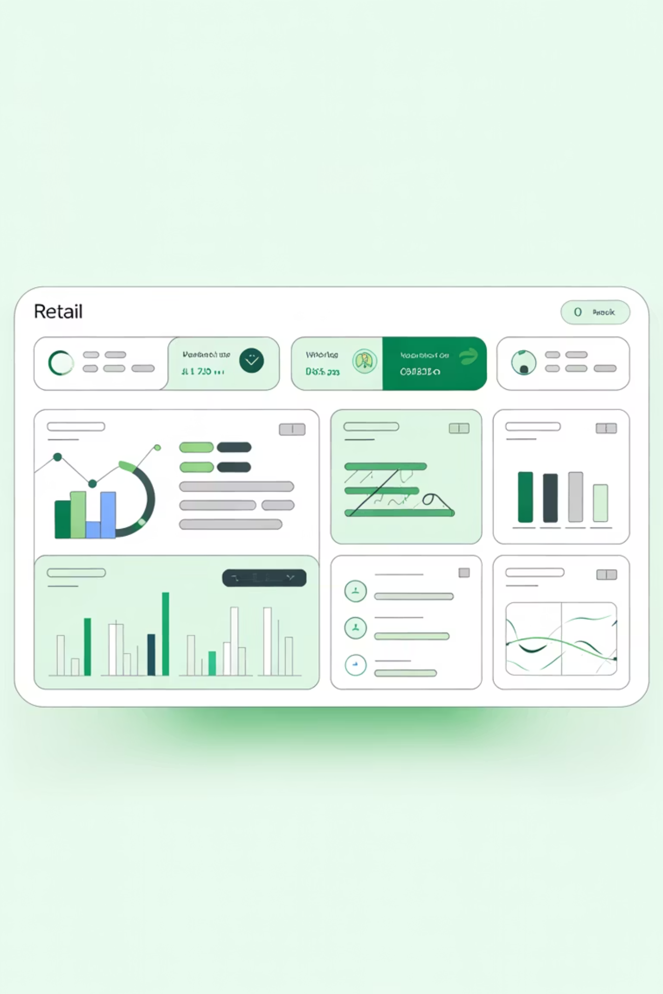
Customer Shopping Behavior Analysis
Uncovering insights from 3,900 purchases to drive strategic business decisions

Slide 2
Dataset Overview
3,900
18
37
25
Total Purchases
Data Columns
Missing Values
Products
Comprehensive transaction data
Customer demographics & behavior
Only in Review Rating Column
Unique items purchased

Slide 3
Data Preparation Process
01
02
Data Loading & Exploration
Missing Data Handling
Imported dataset, checked structure and summary statistics using pandas
Imputed 37 missing review ratings using category medians
03
04
Feature Engineering
Database Integration
Created age groups and purchase frequency metrics
Connected to MySQL for advanced SQL analysis

Slide 4
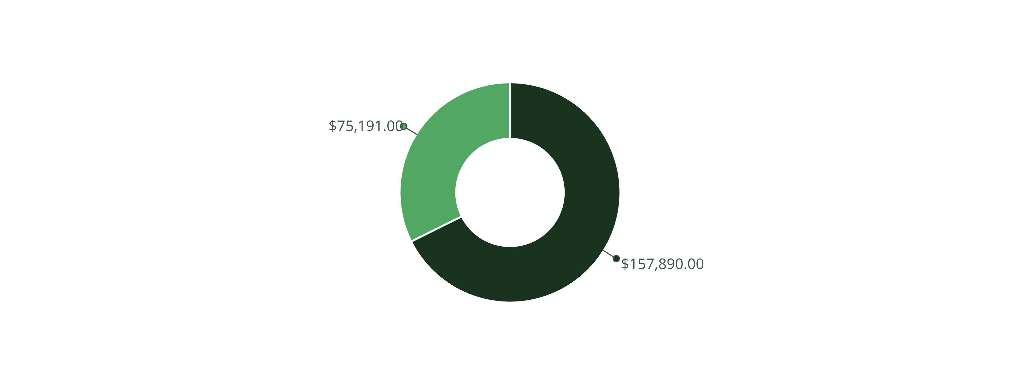
Revenue by Gender Analysis
Male
Female
Male Customers
Female Customers
$157,890 total revenue - 68% of total sales
$75,191 total revenue - 32% of total sales

Slide 5
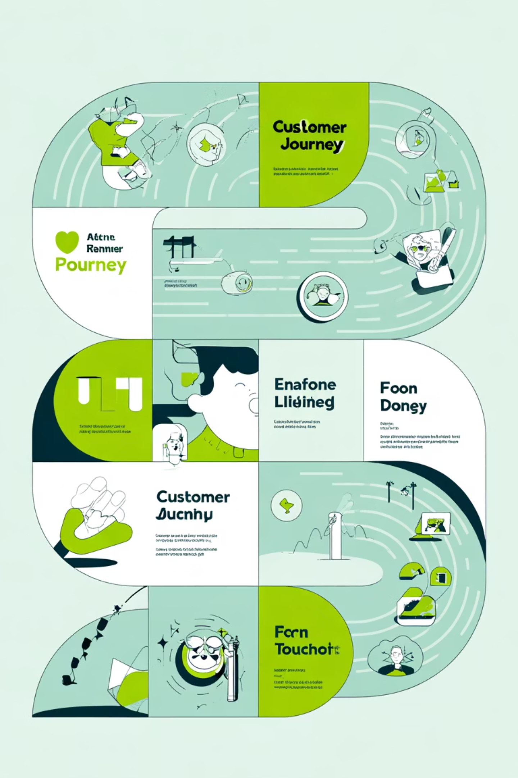
Customer Segmentation Insights
Loyal Customers
Returning Buyers
3,116 customers
701 customers
Largest segment driving repeat business
Growth opportunity segment
New Customers
83 customers
Fresh acquisition pipeline
Focus on converting returning buyers to loyal status for maximum lifetime value

Slide 6


Top Products by Category
Accessories
Clothing
Footwear
Jewelry - 171 orders
Blouse - 171 orders
Sandals - 160 orders
Sunglasses - 161
Pants - 171
Shoes - 150
Belt - 161
Shirt - 169
Sneakers - 145
Highest Rated: Gloves (3.86), Sandals (3.84), Boots (3.82)

Slide 7




Discount Strategy Analysis
50%
49.7%
49.1%
Hats
Sneakers
Coats
Highest discount rate
Nearly half discounted
Heavy discount dependency
Smart Spenders
839 customers used discounts but still spent above average ($60)
These savvy shoppers balance value-seeking with quality purchases.
Strategic Opportunity
Offer exclusive discounts to premium customers to boost loyalty,
drive repeat sales, and strengthen brand preference.

Slide 8
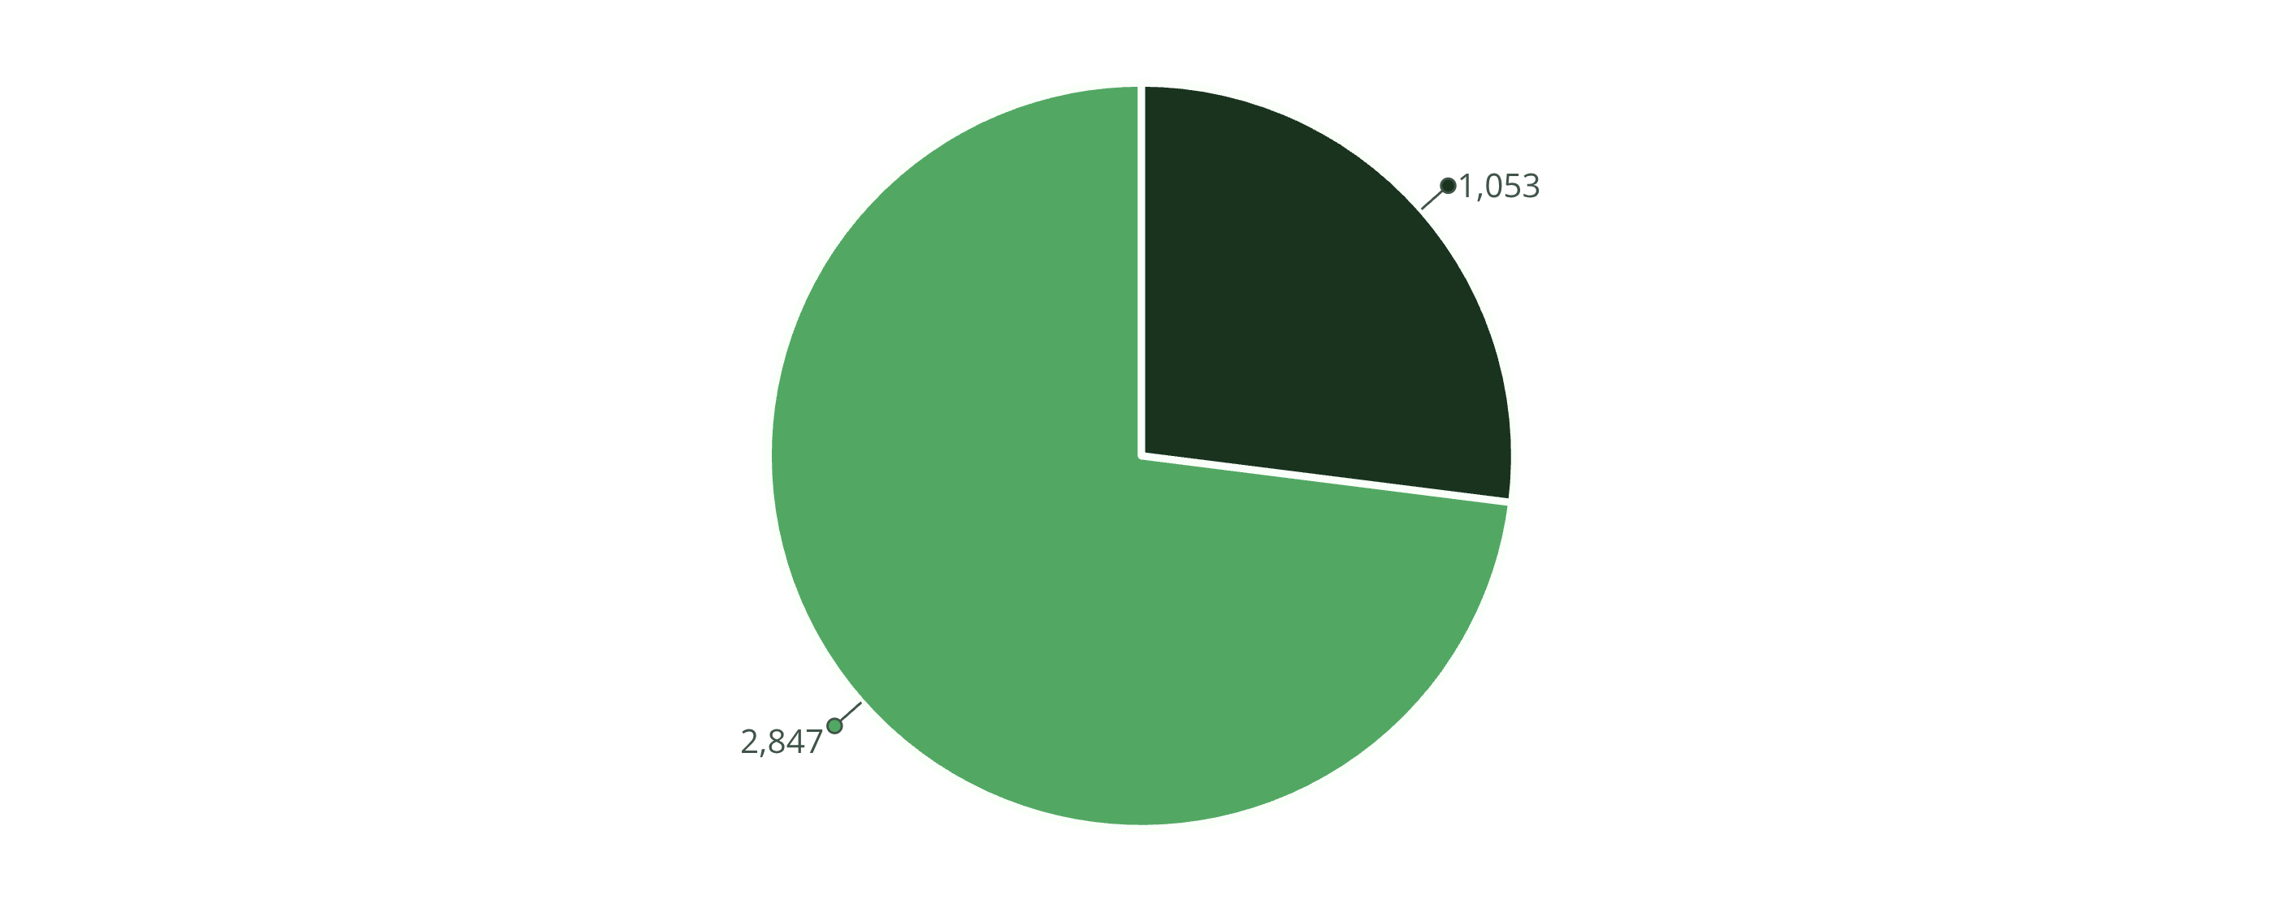
Subscription Impact
Subscribers
Non-Subscribers
Repeat Buyers & Subscriptions
Average Spend Comparison
958 subscribers have 5+ purchases vs. 2,518 non-subscribers
Subscribers: $59.49 | Non-subscribers: $59.87
Opportunity to convert high-frequency buyers
Similar spending patterns across both groups

Slide 9
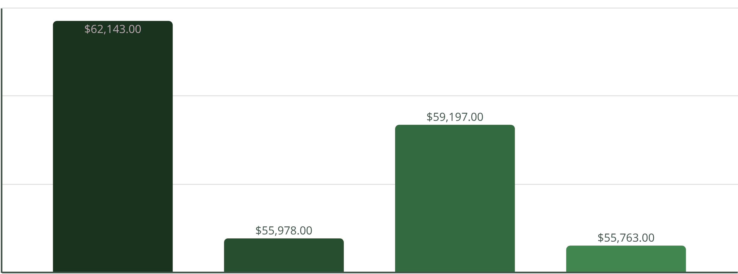
Revenue by Age Group
Balanced Distribution
Balanced distribution across all age segments
Young adults drive the highest revenue overall
Middle-aged customers show strong repeat purchase behavior
Older shoppers have higher average order values despite fewer transactions
Express shipping users spend $60.48 on average vs. $58.46 for standard delivery
Younger buyers favor convenience and faster shipping options
Older customers are more price-sensitive but show strong loyalty once engaged

Slide 10





Strategic Recommendations
Boost Subscriptions
Loyalty Programs
Optimize Discounts
Promote exclusive benefits to convert high-frequency buyers
Reward repeat buyers to grow loyal segment
Balance sales boosts with margin control
Targeted Marketing
Product Positioning
Focus on high-revenue age groups and express shipping users
Highlight top-rated items in campaigns

